Slide 1
Random Variables

Slide 2
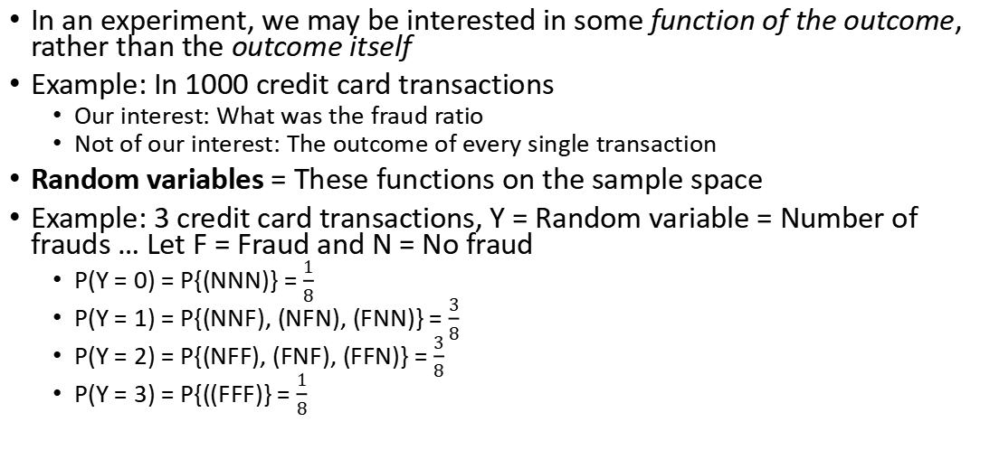
Random Variables
In an experiment, we may be interested in some function of the outcome, rather than the outcome itself
Example: In 1000 credit card transactions
Our interest: What was the fraud ratio
Not of our interest: The outcome of every single transaction
Random variables = These functions on the sample space
Example: 3 credit card transactions, Y = Random variable = Number of frauds … Let F = Fraud and N = No fraud
P(Y = 0) = P{(NNN)} = $\frac{1}{8}$
P(Y = 1) = P{(NNF), (NFN), (FNN)} = $\frac{3}{8}$
P(Y = 2) = P{(NFF), (FNF), (FFN)} = $\frac{3}{8}$
P(Y = 3) = P{((FFF)} = $\frac{1}{8}$

Slide 3
Random Variables: Example
A life insurance agent has two elderly clients with policy value of Rs 1 crore upon death
Y and O are independent
X = Random variable representing the amount of money paid out (in crores) based on who dies
Possible values for X: 0, 1, 2 crore
Event | Probability
Y (Younger one dies) | P(Y) = 0.05
O (Older one dies) | P(O) = 0.10
Random Variable X = | Probability | Calculation | Result
0 (Nobody dies) | P(Y^{c}O^{c}) | 0.95 x 0.90 | 0.855 or 85%
1 (One of them dies) | P(YO^{c}) + P(Y^{c}O) | (0.05 x 0.90) + (0.95 x 0.10) | 0.140 or 14%
2 (Both die) | P(YO) | 0.05 x 0.10 | 0.005 or 0.5%

Slide 4
Random Variable Types
Discrete random variable: Can only take on countable number of possible values
Credit ratings: AAA, AA, B, BBB, etc
Number of orders received on a shopping website (0, 1, 2, 3, …)
Customer churn: 0 = no churn, 1 = churn
Continuous random variable: Can take on any value in a certain interval
Market share of a company (Infinite possible values between 0% and 100%, e.g. 45.123%)
Time taken to place an online order (e.g. 2.5 minutes or 2.55 minutes, etc)
Waiting time at an ATM (e.g. 30.2 seconds or 45.76 seconds, etc)

Slide 5
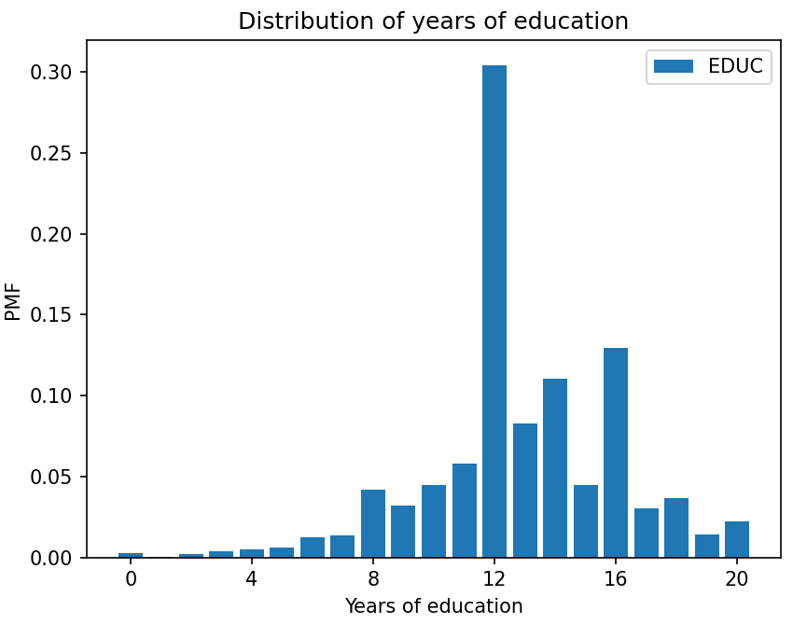
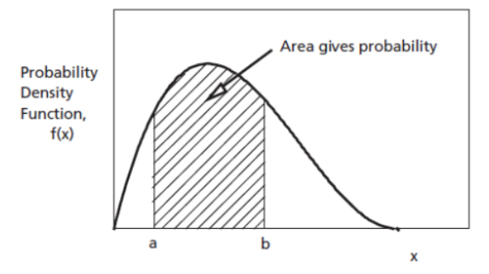
Probability Distribution
Distribution: Describes all the probable outcomes of a variable
Discrete distribution: Sum of all individual probabilities = 1
Continuous distribution: Total area under the probability curve (density) = 1

Slide 6
Probability Distribution Types and Estimations
Probability Distribution Types
Discrete
Continuous
Uniform
Binomial
Poisson
Uniform
Normal
Probability Mass Function (PMF)
Probability Density Function (PDF)
Cumulative Distribution Function (CDF)

Slide 7
Discrete Distributions: (1) Uniform Distribution
Note: Uniform Distribution can also fall under continuous probability distributions category, depending on what we are measuring. If the observations are not discrete, a uniform distribution becomes continuous.
Uniform Discrete Distribution: Throw of a dice (exactly 1, 2, …, 6)
Uniform Continuous Distribution: Time taken by a flight (can go up to nano seconds and beyond)

Slide 8
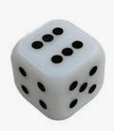
Uniform Distribution
Rolling a fair die: 6 discrete, equally probable outcomes
We can roll a 1 or 2, but not 1.5
The probabilities of each outcome are evenly distributed across the sample space
Code: C:\code\Data Analytics\uniform_dist.py

Slide 9
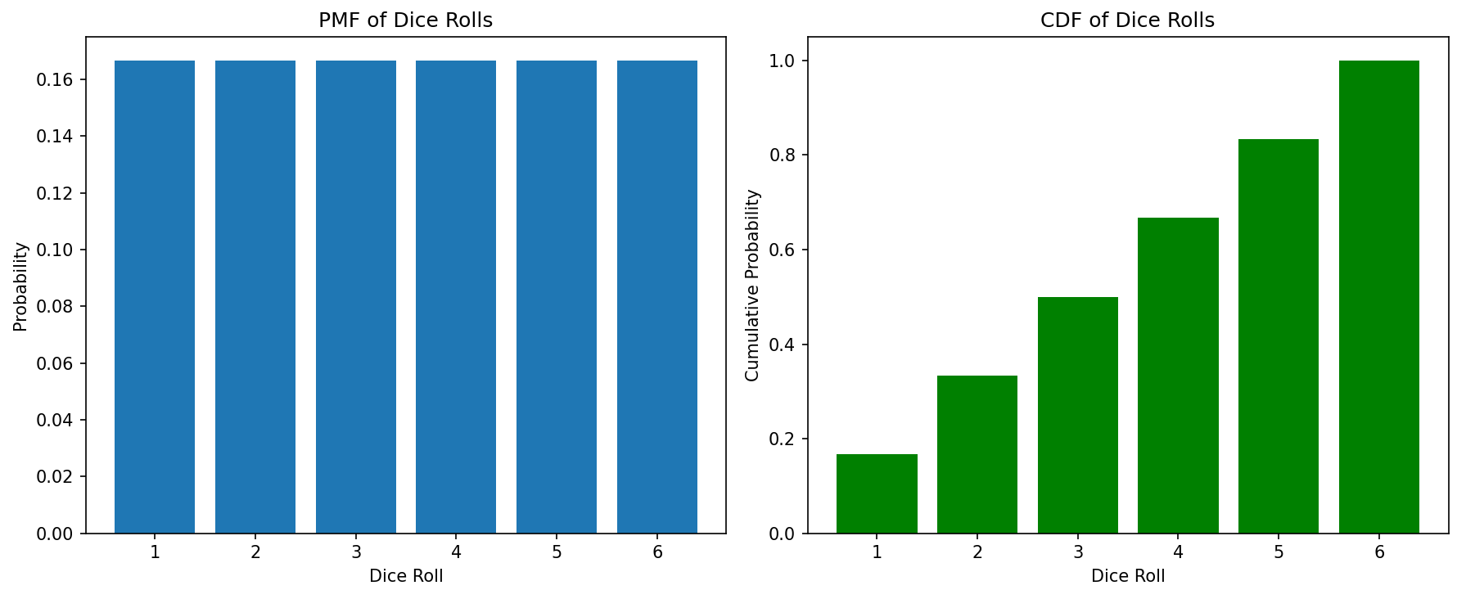
Uniform Distribution
Rolling a die has 6 equal probabilities and their total adds to 1

Slide 10
Discrete Distributions: (2) Binomial Distribution

Slide 11
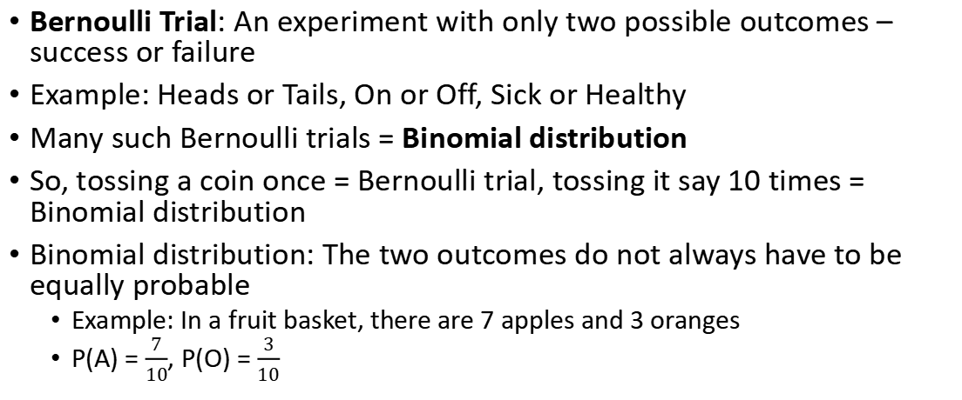
Binomial Distribution
Bernoulli Trial: An experiment with only two possible outcomes – success or failure
Example: Heads or Tails, On or Off, Sick or Healthy
Many such Bernoulli trials = Binomial distribution
So, tossing a coin once = Bernoulli trial, tossing it say 10 times = Binomial distribution
Binomial distribution: The two outcomes do not always have to be equally probable
Example: In a fruit basket, there are 7 apples and 3 oranges
P(A) = $\frac{7}{10}$, P(O) = $\frac{3}{10}$

Slide 12

Binomial Distribution Formula
Problem: Calculate the probability that 3 out of 5 students like Python, when in general 66% students like Python
Number of students liking Python, e.g. 3
Probability that someone likes Python, e.g. 66%
p(x | n, p) = $\left(\frac{n!}{x!\left(n−x\right)!}\right)px \left(1−p\right)n−x$
Probability
Number of students we asked, e.g. 5

Slide 13
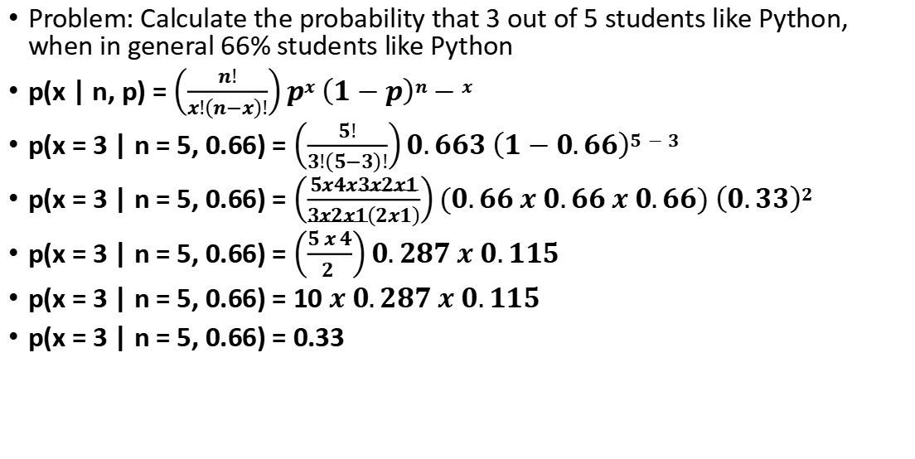
Binomial Distribution Example
Problem: Calculate the probability that 3 out of 5 students like Python, when in general 66% students like Python
p(x | n, p) = $\left(\frac{n!}{x!\left(n−x\right)!}\right)px \left(1−p\right)n−x$
p(x = 3 | n = 5, 0.66) = $\left(\frac{5!}{3!\left(5−3\right)!}\right)0.663 \left(1−0.66\right)5−3$
p(x = 3 | n = 5, 0.66) = $\left(\frac{5x4x3x2x1}{3x2x1\left(2x1\right)}\right)(0.66 x 0.66 x 0.66) \left(0.33\right)2$
p(x = 3 | n = 5, 0.66) = $\left(\frac{5 x 4}{2 }\right)0.287 x 0.115$
p(x = 3 | n = 5, 0.66) = 10 $x$ $0.287 x 0.115$
p(x = 3 | n = 5, 0.66) = 0.33
Result: Binomial Probability Mass Function (PMF)

Slide 14
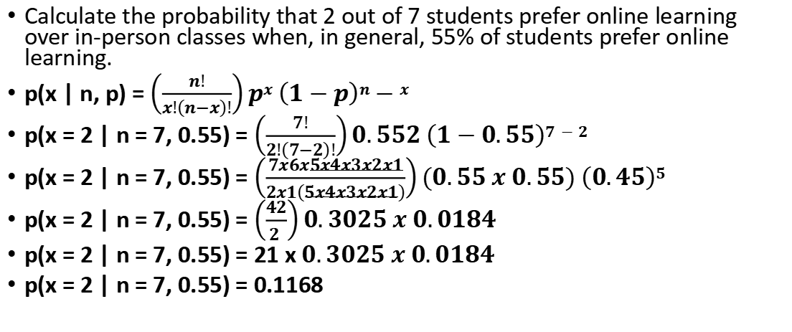
Exercise (Solve + Code)
Calculate the probability that 2 out of 7 students prefer online learning over in-person classes when, in general, 55% of students prefer online learning.
p(x | n, p) = $\left(\frac{n!}{x!\left(n−x\right)!}\right)px \left(1−p\right)n−x$
p(x = 2 | n = 7, 0.55) = $\left(\frac{7!}{2!\left(7−2\right)!}\right)0.552 \left(1−0.55\right)7−2$
p(x = 2 | n = 7, 0.55) = $\left(\frac{7x6x5x4x3x2x1}{2x1\left(5x4x3x2x1\right)}\right)(0.55 x 0.55) \left(0.45\right)5$
p(x = 2 | n = 7, 0.55) = $\left(\frac{42}{2 }\right)0.3025 x 0.0184$
p(x = 2 | n = 7, 0.55) = 21 x $0.3025 x 0.0184$
p(x = 2 | n = 7, 0.55) = 0.1168

Slide 15
Understanding PMF and CDF
Probability Mass Function (PMF): Probability at a specific point
Cumulative Distributed Function (CDF): Cumulative probability up to a specific point
Example: Consider tips dataset
Suppose we define success as tip >= 15% of the total bill amount
PMF = Probability for each possible number of successful tips, e.g.
P(X=0) -> Probability that none of the tips are at least 15%
P(X=1) -> Probability that exactly one tip is at least 15%
P(X=2) -> Probability that exactly two tips are at least 15%
… up to the total number of tips
CDF = Cumulative probability at that point

Slide 16
Plotting PMF and CDF
Now calculate the probability that we will get this success in 60 or 65 out of 100 customer visits
Plot PDF and CDF and highlight these points (60 and 65) on the plot
Exercise: Calculate overall survival rate in titanic dataset and plot the PDF and CDF

Slide 17
Discrete Distributions: (3) Poisson Distribution

Slide 18
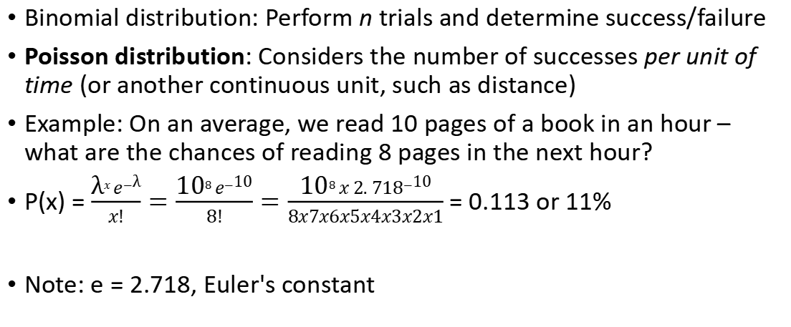
Poisson Distribution
Binomial distribution: Perform n trials and determine success/failure
Poisson distribution: Considers the number of successes per unit of time (or another continuous unit, such as distance)
Example: On an average, we read 10 pages of a book in an hour – what are the chances of reading 8 pages in the next hour?
P(x) = $\frac{\text{λ}x e−\text{λ}}{x!}=\frac{\text{10}8 e−\text{10}}{8!}=\frac{\text{10}8 x 2. 718−\text{10}}{8x7x6x5x4x3x2x1}$ = 0.113 or 11%
Note: e = 2.718, Euler's constant

Slide 19
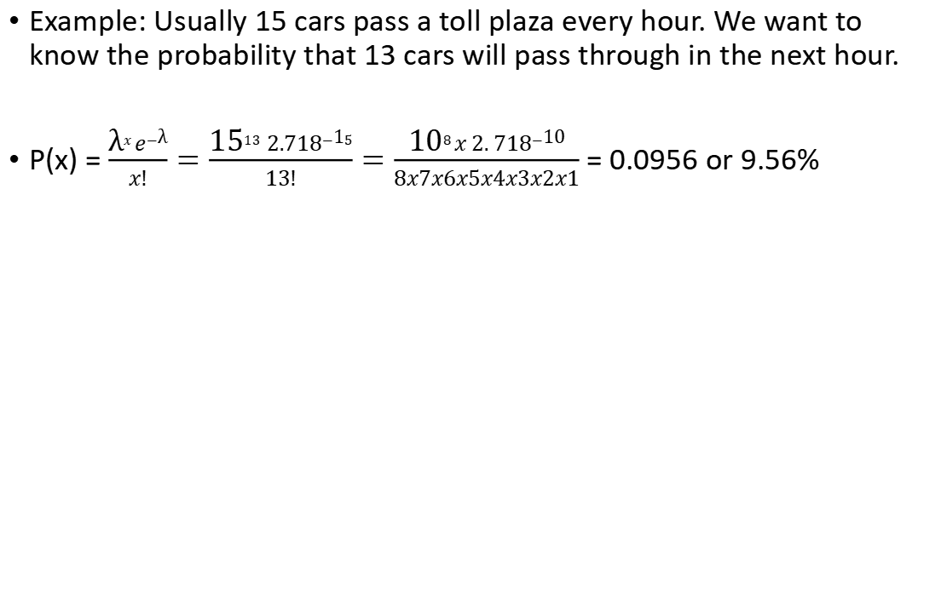
Poisson Distribution
Example: Usually 15 cars pass a toll plaza every hour. We want to know the probability that 13 cars will pass through in the next hour.
P(x) = $\frac{\text{λ}x e−\text{λ}}{x!}=\frac{\text{15}13 2.718−\text{1}5}{13!}=\frac{\text{10}8 x 2. 718−\text{10}}{8x7x6x5x4x3x2x1}$ = 0.0956 or 9.56%

Slide 20
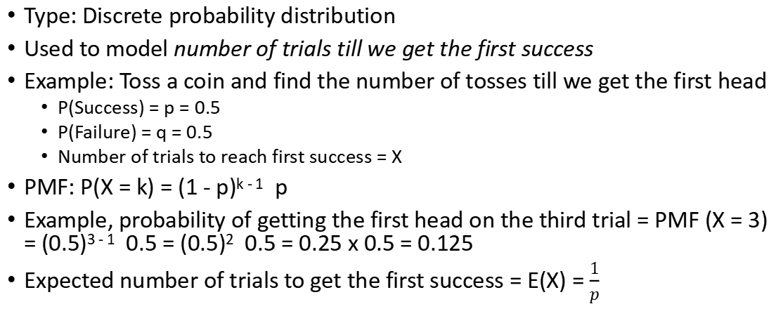
Geometric Distribution
Type: Discrete probability distribution
Used to model number of trials till we get the first success
Example: Toss a coin and find the number of tosses till we get the first head
P(Success) = p = 0.5
P(Failure) = q = 0.5
Number of trials to reach first success = X
PMF: P(X = k) = (1 - p)^{k - 1} p
Example, probability of getting the first head on the third trial = PMF (X = 3) = (0.5)³ ⁻ ¹ 0.5 = (0.5)² 0.5 = 0.25 x 0.5 = 0.125
Expected number of trials to get the first success = E(X) = $\frac{1}{p}$

